Slide 1
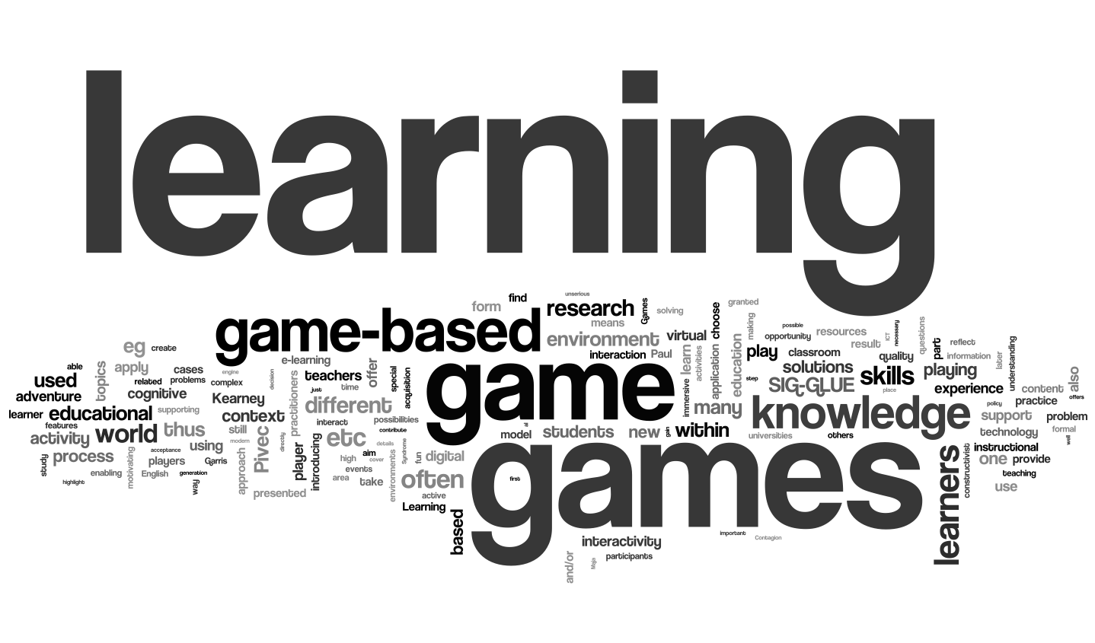
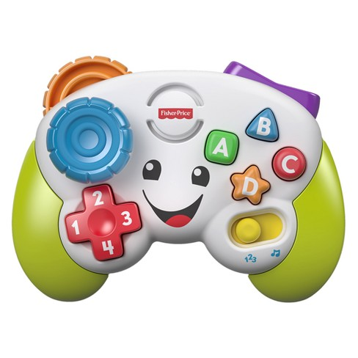

In The Name Of ALLAH
TAVSS CARD version 1
TAs VS Stu Competition
Abstract
TAVSS is a big solution for developing professional IT Guys and students
By generating good Team Working and funny IT competitions between Groups of students ; I suppose that if students using it ,Huge number of students will be professional in studying their Tutorials and Courses, TAVSS
Has 2 project : Competition project and Courses Project , the Competition project has 1 Application and a game
Course Project has the Course App
Explaining my solution
TAVSS is our whole sln that have 2 projects let’s explain Them :
. Competetion project :
- Compete App : TAs adds the students in Groups in one filed , then every student upload their projects in their repos , then evaluated by TA the higher evaluated student is the best rank must have the great marks .
- Brain Connection Game : is a game where The courses groups can be assigned to it , then the TAs can generate a questions model , every question is a bullet shoot to a student ,
The student paid for their Defenders , if the student defend himself from one shoot he get a mark , the most higher ranked 3 students gain all the money .
. Course project :
- Course Application : Doctors can creates their course with the sources and materials and upload the tutorials , TAs then adds their groups of students in specified course , students learn ,study , and abstract every topic in tutorials in their own words in A wiki model and has its blogging system that students can ask , and be answered by another student.
Solution
TAVSS
2projects
Project
Competition
2 Applications
project
Application
Compete App
BC game
Courses
Introduction
The problem : Students have less interaction with TAs and Doctors as they can’t find any enjoyable , profitable , attractive relationship between Teaching staff , this problem come from the depression , complex , sadness methods of Teaching .
I found That most of students play games to bridge the gaps of these trivial methods , in last year : the students play like greedy drug dealers to get the best scores in trivial games like PubG .......etc
I
In The Name Of ALLAH
Progeng_Ahmed_Khalil@outlook.com
©Ahmed Khalil

